Slide 1
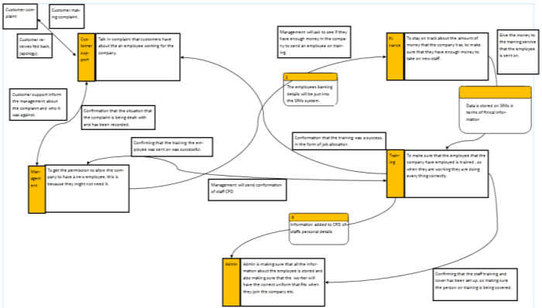
Cambridge Technicals – Unit 02 – DFD’s
How to create a Data Flow Diagram using Game and Sarson Method.
Unit 02 – Information Systems

Slide 2
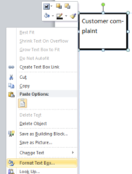
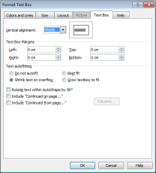
1 – DFD Walkthrough Guide – Initial Information
Task 1: How to Make a DFD Diagram
The first stage of any DFD is to get the format for the Data Flows and the respective Processes, Data Stores, Sources and Data Flows. We start by drawing the shapes we can use and the formats of them to duplicate throughout the process.
Step 1 Go into Publisher and start a new A3 Landscape document. Then Create a Text Box and put a Border on it. Then right click on it and select Format Shape. Click on Alignment to Middle and Text Box margins to 0. Then change the Text Autofitting to Shrink Text to Autoflow.

Slide 3
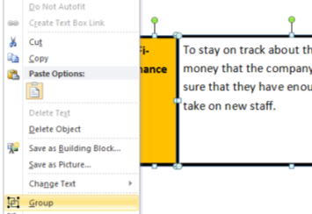
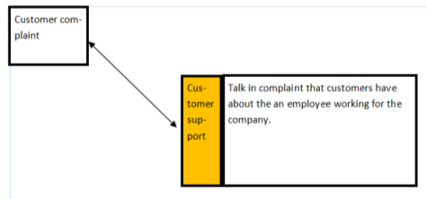
1 – DFD Walkthrough Guide – Initial Information
Task 1: How to Make a DFD Diagram
Step 2 – Create two new boxes and use the same formatting as the previous step. Colour one in yellow and place the second larger one beside it. This can be done quicker by coping and pasting the first box created in step one and widening it. Then right highlight both boxes, right click and group them.

Slide 4
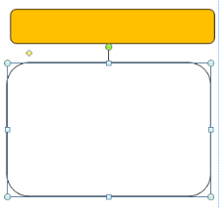
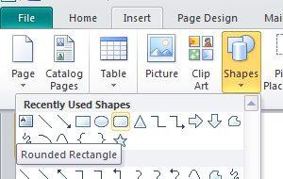
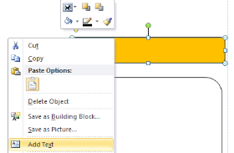
1 – DFD Walkthrough Guide – Initial Information
Task 1: How to Make a DFD Diagram
Step 3 – Create two new boxes using the curved box tool. Colour the top one in yellow and set the text formatting the same as Step 4. Put some preparation text in both and make sure the yellow box is on top of the white one. To do this, right click inside the box and select Add Text.

Slide 5
1 – DFD Walkthrough Guide – Initial Information
Task 1: How to Make a DFD Diagram
A Customer makes a complaint to Customer support over the way they were treated by a member of the sales staff.
Customer Support talks to Management about the complaint (2 way)
Management talk to Sales about the complaint (2 way)
Management talk to Human resources about the decision to organise training for the member of staff (1 way)
Human resource organise training for the sales staff (1 way)
Human Resources organise payments for the training. Payment is confirmed (2 way)
Finance transfer funds from the Human Resources training fund and confirm this (1 way)
Sales department releases staff member for training (1 way)
Training contact Human Resources when Training is complete (2 way) so employee gets trained how to do the job (2 way)
Training contact HR to confirm this (1 way)
HR contact Customer Services to confirm this (1 way)
Human Resources contact Sales later to confirm situation is resolved (2 way)
Step 4 – It should now look like the box below. For this task we will be following the steps on the right to make a DFD of how the information flows.

Slide 6
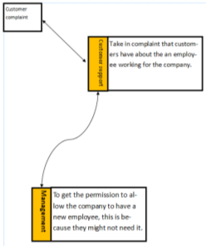
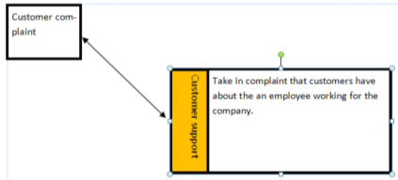
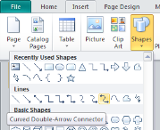
1 – DFD Walkthrough Guide – Initial Information
Task 1: How to Make a DFD Diagram
A Customer makes a complaint to Customer support over the way they were treated by a member of the sales staff.
Customer Support talks to Management about the complaint (2 way)
Step 5 – We copy and paste the yellow Processes boxes and join them with arrows, either straight or bendy, makes no difference yet but might later when it gets more complicated.

Slide 7
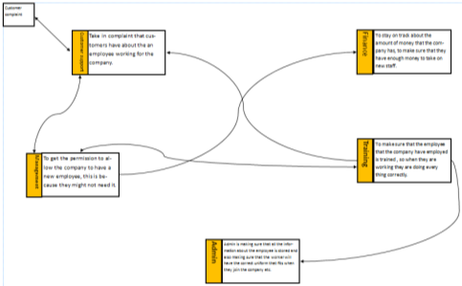
1 – DFD Walkthrough Guide – Initial Information
Task 1: How to Make a DFD Diagram
A Customer makes a complaint to Customer support over the way they were treated by a member of the sales staff.
Step 6 – Next you get the rest of the Data Stores in place using the single and double arrows and an indication of the information stored within. There should not be a Data Store that has not got some in and out information.

Slide 8
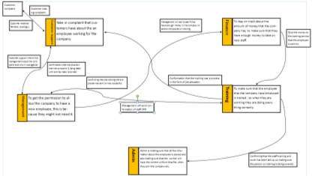
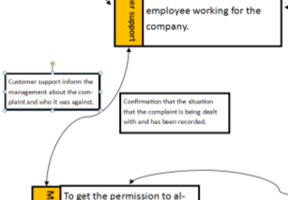
1 – DFD Walkthrough Guide – Initial Information
Task 1: How to Make a DFD Diagram
A Customer makes a complaint to Customer support over the way they were treated by a member of the sales staff.
Step 7 – Next, nearly all information that flows goes two ways so each line that has been created needs to have a box above stating the information type and a box below stating the return information. This is called the Source/Sink. If the line is vertical (up and down) the left hand side is the outgoing information and the right hand side the incoming information.

Slide 9
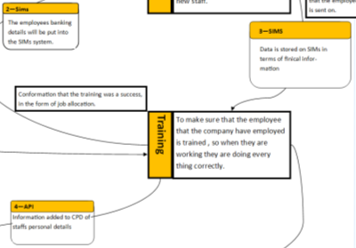
1 – DFD Walkthrough Guide – Initial Information
Task 1: How to Make a DFD Diagram
A Customer makes a complaint to Customer support over the way they were treated by a member of the sales staff.
Step 8 – Next, we have the process, the store of information on the MIS system (Sims, Alice, API, EPOS) and how this information is communicated this information is managed through the process. This is where our curved boxes come in. The numbers in the boxes indicate the order the information is handled.
2 - SIMS
The employees banking details will be put into the SIMs system.

Slide 10
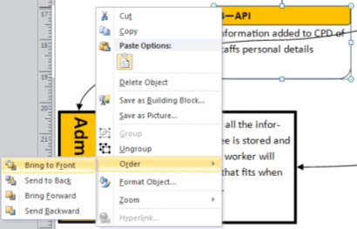
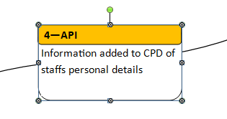
1 – DFD Walkthrough Guide – Initial Information
Task 1: How to Make a DFD Diagram
A Customer makes a complaint to Customer support over the way they were treated by a member of the sales staff.
Step 9 – The last Phase of this is to interrupt the lines that the boxes overlap onto rather than have the arrows flow through them. First right click on the boxes after grouping them and order them to the front. This should then cause the lines to go to the back.

Slide 11
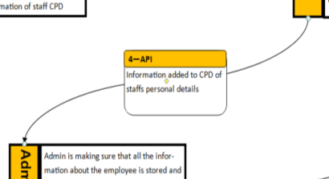
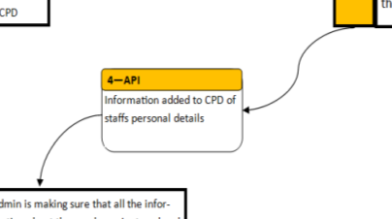
1 – DFD Walkthrough Guide – Initial Information
Task 1: How to Make a DFD Diagram
A Customer makes a complaint to Customer support over the way they were treated by a member of the sales staff.
Step 10 – Now we have to rebuild the lines so that they end and begin each time at the Process boxes to indicate the flow of information into the system. To do this simply move the lines, duplicate them and connect them to the process boxes. And if it is a double line then do double arrows.

Slide 12
1 – DFD Walkthrough Guide – Initial Information
Task 2: Alternative Scenarios - How to Make a DFD Diagram
Warehousing need more staff to work night shifts in the Supermarket
Warehousing talk to HR about getting a new member of staff (2-way) HR talk to Finance on whether they can afford new staff. Finance agree to this (2-way) HR talks to and places an ad to an External Job Agency about the vacancy (1-way) HR asks Finance to pay for the Ad with confirmation (2-way) Finance Pay for the Ad (1-way) Agency send a prospective employee to HR for the interview. HR sends back work on the successful recruitment (2-way) HR sends the new employee for Training (1-way) Training communicate with Warehousing on needs (2-way) Finance tell Admin to organise for new employee sundries and salary (work gear, badge etc.) (1-way) Training send employee to Warehousing when training is complete (1-way) HR checks within a month with Warehousing if the employee has passed their probation period (2-way)

Slide 13
1 – DFD Walkthrough Guide – Initial Information
Task 2: Alternative Scenarios - How to Make a DFD Diagram
Marketing and Publicity are merging departments within a downsizing retail store.
Management talk to Finance about the decision to merge Publicity and Marketing departments (2-way) Finance organise with HR new contracts (1-way) HR talks to Publicity department and Marketing about redundancies (2-way) Publicity department and Marketing talk to the Union about terms (2-way) Admin organise with Maintenance on the move (1-way) Maintenance merge the two departments (1-way) Admin organise with IT support the new network construction (1-way) Admin and Finance organise new terms and pay conditions (2-way) Admin organise Training for the new department (2-way) Confirmation of training is passed on through HR (1-way)

Slide 14
1 – DFD Walkthrough Guide – Initial Information
Task 2: Alternative Scenarios - How to Make a DFD Diagram
A new student joins the school from another school due to behavioural issues.
Parents discuss with the Senior Management on the students acceptance (2 way) Admin get records of the student from prior school (1 way) Admin arrange Network Login and access details with the IT department (1 way) Finance gain funding from Local Area Authority for the student (1 way) Admin update Sims for student details and classroom lessons with Student Support (1 way) Student Support contact SEN department to organise students needs (2 way) Senior Management organise Form arrangements with houses (1 way) SEN organises with Teachers the students arrangements (1 way) Finance organise with Admin on student card, uniform and meal arrangements (1 way) Student starts school day with everything in place

